Slide 2
Gisborne Secondary College acknowledges the Wurundjeri people as the traditional owners of the country upon which we learn and work. We recognise their continuing connection to land, water and community and pay respect to Elders past, present and emerging.

Slide 3
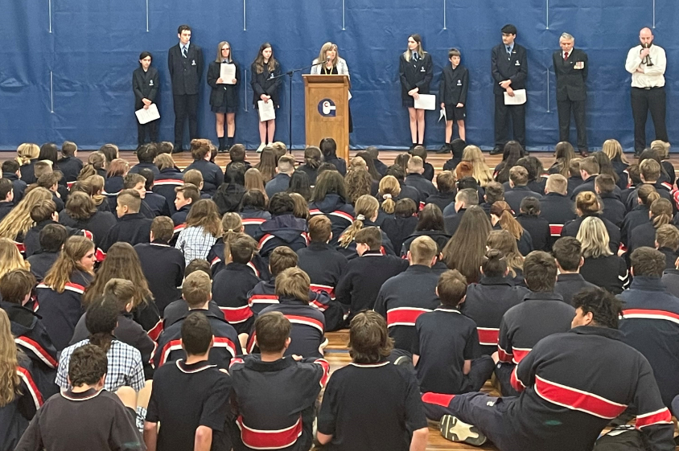
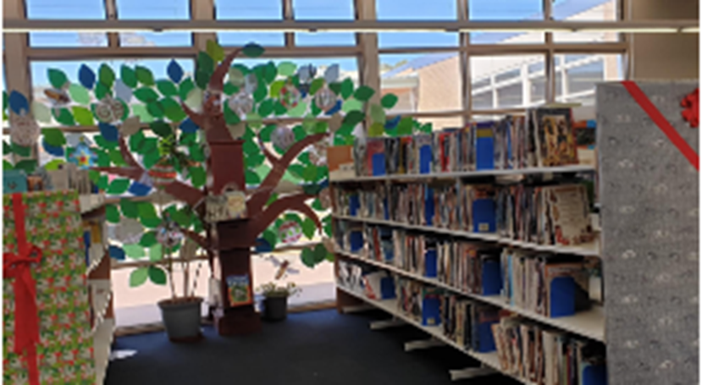
Senior School Welcome and Introductions
Sarah Rose
Acting Principal
Senior School Wellbeing and Engagement Leader – Christopher Hewitt
Senior School Curriculum and Programs Leader – Lauren Anglin
Year 12 Coordinator – Greg Savvinos
Wellbeing Leader – Belinda O’Meara
Careers – John Tikulin
Senior School Support Staff – Megan Penn and Heather Livermore
Richard Palmer
Acting Assistant Principal

Slide 4
Important Dates and Assessment Calendar
Term One –
Coursework, SACs and SATs
Term Two –
Coursework, SACs and SATs
Term Three –
Coursework, SACs and SATs.
VTAC Applications Open and Info Night
September 7 GAT
Term Four –
Revision Lectures
Final Classes
Exams commence 27 October
November – Graduation Dinner
gisbornesc.vic.edu.au

Slide 5
Year 12 Results
2020
2021
VCE Completion – 97%
Median VCE Study Score – 26
Study scores 40 + - 2.1%
English Study Score Mean – 26.6
VCAL unit completion 76%
VCE Completion – 98%
Median VCE Study Score – 28
Study scores 40 + - 4.8%
English Study Score Mean – 27.4
VCAL unit completion 83%
*VET results not available at this time
*English does not incorporate Lit and Eng Lang as the 2020 data didn’t.

Slide 6
2021 ATAR statistics
Students above 90 – 7%
Students above 80 – 18%
Students above 70 – 32.5%
Students below 50 – 31.5
Other highlights:
Duxes – Emma Bamford and Tara Thomsen – 98.15
Beth Walker study score – 50 in Visual Communication and design

Slide 7
Study Scores and ATAR Calculation
A study score is determined using the following:
A study score is a ranking that indicates how a student performed in relation to all others who took the same study.
https://vcaa.vic.edu.au/assessment/results/Pages/StudyScoreVideos.aspx
gisbornesc.vic.edu.au

Slide 8
Statistical Moderation
Because all schools assess their students differently, VCAA needs to convert a students School based Assessment scores (SAC’s and SAT’s) to a common scale.
This means that any marks a student gets at school, may change in their end of year results, as a result of VCAA moderation processes.
Statistical moderation does not change the rank order of students as determined by the school’s school-based scores. A student given the top score for school-based assessments by his or her school will have the top score after statistical moderation, no matter how they perform on the exam(s).
For further information on statistical moderation, please see:
https://www.vcaa.vic.edu.au/Documents/statmod-brochure.pdf
gisbornesc.vic.edu.au

Slide 9
Scaling of Study Scores
Before study scores can be used to calculate an ATAR, they are scaled by VTAC to adjust for the fact that it’s harder to obtain high marks in some studies than others.
This reflects the differences in the strength of competition within the students in that subject as compared to other subjects. It is not based how ‘hard’ a subject is perceived to be.
Scaled scores are used in the calculation of the ATAR score.
gisbornesc.vic.edu.au

Slide 10
What is the ATAR
The Australian Tertiary Admission Rank (ATAR) is an overall percentile rank reflecting a student’s Year 12 achievement compared to whole age group in a given year.
It is not a score, and there is no pass or fail ATAR. Everyone who receives an ATAR has passed the VCE.
The ATAR allows tertiary institutions to competitively rank students who have completed different combinations of VCE studies.
The ATAR is reported as a number between 0.00 and 99.95. A student with and ATAR of 75.00 has achieved VCE results above 75% of the Year 12 group.
gisbornesc.vic.edu.au

Slide 11
ATAR SCORES
Your ATAR score is determined using the following:
The Scaled study score in English, Literature, or English Language
The next best three scaled study scores
10% of any fifth and/or sixth ATAR subject score that is available
In all, up to six ATAR subject scores may be used in calculating your aggregate score.
gisbornesc.vic.edu.au

Slide 12
SAMPLE ATARS
Subject | Results | VCE Study Score | Scaled Score
1. English | C+ B B | 29 | 27 +
2. Health | B+ B+ C+ | 30 | 25 +
3. Biology | C+ C+ C+ | 28 | 28 +
4. Further Maths | B B C | 30 | 27 +
5. Physical Education | C+ C C | 24 | 22 (2.2) =
Aggregate Score |  |  | 109.2
ATAR Score
55.90

Slide 13
Subject | Results | VCE Study Score | Scaled Score
1. English | A+ A+ A+ | 40 | 40 +
2. Legal Studies | A A B+ | 34 | 34 +
3. Chemistry | B+ C+ C+ | 32 | 32 +
4. Maths Methods | B+ B C+ | 35 | 35 +
5. Literature | B B C+ | 27 | 27 (2.7) =
6. Informatics | B C+ C | 27 | 27 (2.7)
Aggregate Score |  |  | 145.9
ATAR Score
88.35

Slide 14
Subject | Results | VCE Study Score | Scaled Score
1. English | A A B | 34 | 32 +
2. Health | A+ A+ A+ | 43 | 41 +
3. PE | A+ A+ A+ | 42 | 40 +
4. Geography | A+ A A | 39 | 39 +
5. Further Maths | A A+ A+ | 40 | 38 (3.8+
6. Physics | B A B+ | 33 | 35 (3.5)=
Aggregate Score |  |  | 159
ATAR Score
90.05

Slide 15
Some perspective……
The sole purpose of the ATAR is to assist tertiary institutions in the selection process.
Your ATAR is not reflective of your intelligence, and it should not define your life
Success will look different for each student, and all we as a school can ask, and all you can ask of yourself is that you try your hardest every day
gisbornesc.vic.edu.au

Slide 16
The VCE Program
Students completing year 12 will have obtained 10 – 12 1&2 units in 2021 and a 3&4 sequence if they accelerated. They must have units from English, English Language or Literature.
In year 12 Students complete 5 unit 3&4 sequences. Including the mandatory English, English Language or Literature.
Students at Gisborne also complete Connect. This program at year 12 aims to prepare students for academic success, further study and life beyond school.
Elevate – Study Skills
Revision Lectures
Tertiary Application Processes
Practice Exams and Exam Skills
Students will have one ‘spare’ in their timetable giving them 4 periods a week to work in the study centre to complete some of their study and coursework.
gisbornesc.vic.edu.au

Slide 17
The Handbook
Rules and guidelines
Acknowledgement
Expectations
Copies have been provided to students and parents

Slide 18
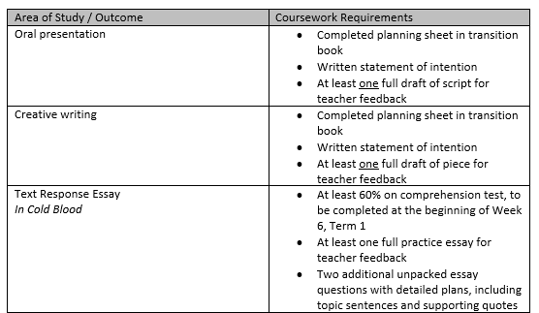
Coursework

Slide 19
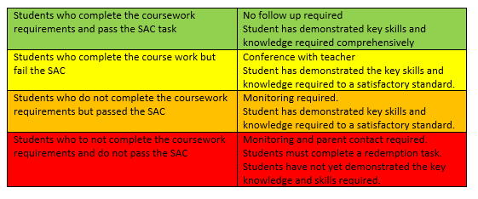
Satisfactory outcome completion

Slide 20
Redemptions, Catch-up and Special Provision
Redemptions are booked for Thursday nights after school in L1
Catch-ups can be booked in senior school office during a spare or in the redemption timeslot.
Special Provision:
Applications can be made to VCAA to access Special Exam Arrangements.
The school makes applications on behalf of students who have a diagnosis that requires them to have different arrangements in order to show their learning.
The school can not change the outcomes a student is required to meet or the nature of the task itself.
gisbornesc.vic.edu.au

Slide 21
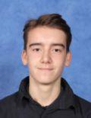
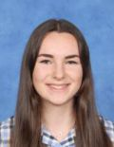
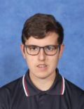
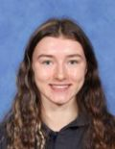
College Captains
Captains:
Oscar James
Bridget Holmes
Vice Captains:
Thomas Hofer
Sienna Andrews
gisbornesc.vic.edu.au

Slide 22
How to survive and thrive in Year 12

Slide 23
Balance
School life
Home life
Work life
Social life
Future life
Personal life

Slide 24
My Team
Me
My teachers
My family
My friends
GSC support
Year Level Leader
Careers
Wellbeing
Senior School Leaders
Outside agencies
Notes:
Talk to people
Keep and eye on your friends
Changed relationships with staff

Slide 25
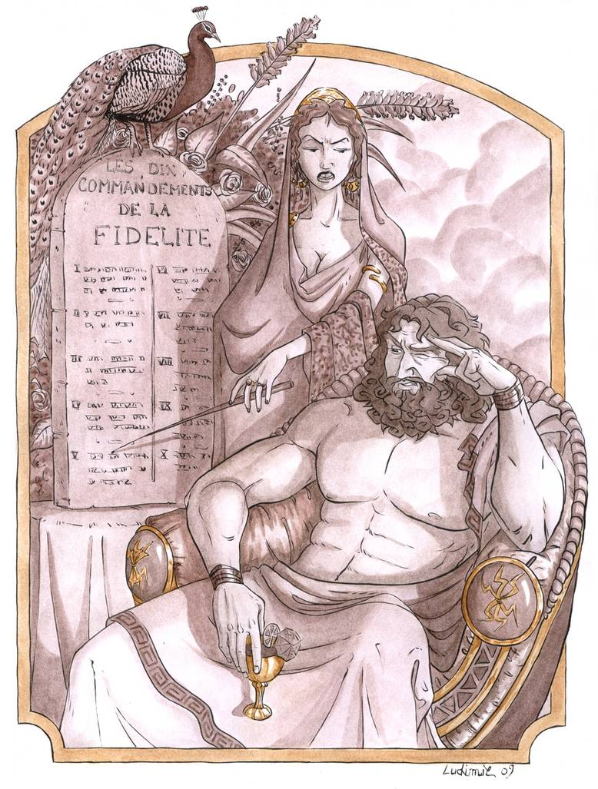
The Role of Parents in Year 12
Helping to keep the balance between school, work and home
Provide a quiet and secure place to study.
Being a parent, not a friend
Knowing your son/daughter and letting us know if you have any concerns
Attendance.
Notes:
Students are still part of the family; they have responsibilities.
Showing interest
Ask the right questions

Slide 26
Resources
The College
Each other
Parents and family
Useful websites
Tertiary Open Days

Slide 27
Senior Student Agreement Form
In 2022 Senior School is implementing the Senior Student Agreement Form. This form is to ensure that all senior students acknowledge and agree to the specific policies of both the GSC and the Victorian Curriculum and Assessment Authority. Upon signing the agreement, it will be assumed that the student has read and understood the contents of the Senior School Students Handbook.
Senior Student Agreement Form will be handed to Year 12 students in Connect on 21/02/22.

Slide 28
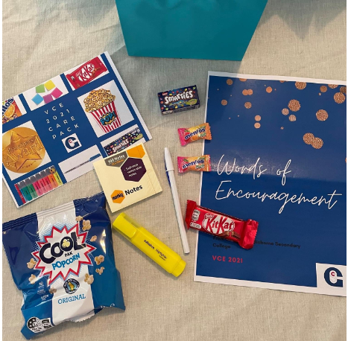
Wellbeing
At Gisborne Secondary College we aim to provide a safe, respectful and inclusive environment for students and their families. We place a high priority on the wellbeing of all members within the college community. We understand the relationship between wellbeing and student outcomes, and take an integrated approach to wellbeing. All staff play an important role in wellbeing and this includes: mentors, classroom teachers, year level leaders and principal class.
We have a dedicated Wellbeing Team to support wellbeing practices throughout the college. This includes counsellors, youth workers, psychologists and a creative arts therapist.
Several programs/groups focused on student health and wellbeing run across the college, including:
Respectful Relationships
Pride Crew
Breakfast Club
Peer Support
Live4Life
Mental Health First Aid
Lunchtime groups – art therapy, ukulele

Slide 29
Careers
Gisborne Secondary College understands that all students (and parents) require personal support and assistance when making vocational decisions for the future
The Careers team can assist students to identify appropriate pathways, particularly for 2023 and beyond
Apprenticeships Information | Scholarship Opportunities
Cadetships & Traineeships | Subject Selection Counselling
Career Expos | Special Consideration (SEAS)
Careers Testing | TAFE Courses & Programs
GAP Year Opportunities | University Courses & Programs
Interstate Universities | University / TAFE Early Entry
Job Interview Skills | VCE Course Counselling
Open Days (Uni. / TAFE) | VET in Schools
1:1 Careers Counselling | VTAC (Uni./TAFE Applications)
Résumé Writing Skills | Weekly Career News Updates

Slide 30
1. VTAC Applications
# of Year 12 applications 75 (out of 105 students) 72%
# of offers made 73 (97%)
2. VTAC 1st Preferences
% of Year 12 receiving 1st preference 70%

Slide 31
3. Types of Tertiary courses offered
Bachelor Degree 56
Associate Degree 2
Advanced Diploma 1
Diploma 8
Cert. IV 6
4. Universities
La Trobe (Bendigo & Bundoora) 21
RMIT 19
Deakin Uni. 13
Vic. Uni (VU) 6
Uni. Of Melbourne 4
Aust. Catholic Uni. (ACU) 3
Monash 3

Slide 32
5. Range of courses by domain
Health 23 | Psychology (6), Health Sciences (4), Nursing (4), Speech Pathology (2) , Midwifery (2), Nutrition (2), Allied Health (2), Osteopathy (1), Chiropractic (1)
Science 10 | Biomedicine (5), General Science (3), Zoology (2)
Commerce/ Law 8 | Business (2), Law (2), Criminology (2), Accounting (1), Advertising (1)
Humanities 6 | Art (4), Global Studies, Gender Studies
Sport / Fitness 5 | Sport Management (3), Fitness (2)
Education 4 | Primary (3), Secondary (1)
Engineering 4 | Aerospace; Manufacturing; Mechanical.
IT. 3 | Cyber Security (2); Computer (1)
Language 2 | Journalism; Creative Writing
Art 2 | Interior Design; Film

Slide 33
6. Employment and training
Apprenticeships 20 | Plumbing (6) Carpentry (6) Hair/Beauty (5) Auto (2)
Full Time Work 12 | Retail; Hospitality;
Traineeships 2 | Real Estate Warehousing

Slide 34
7. Where to next for 2023?
By the end of the year, a. VTAC Tertiary (Uni. & TAFE) enrolments b. Interstate Uni. Applications (optional) c. Direct applications to TAFE e. Seek employment – (Traineeship; Apprenticeship; Cadetship) -register with an Employment Agency

Slide 35
Theme for the Year and Life
Be the best … be the bravest!.

